Slide 1
Introduction to Data Communication and Networks
CSC 223

Slide 2
Data Communications
Communication is defined as transfer of information, such as thoughts and messages between two entities.
  The invention of a telegraph, radio, telephone, and television made possible instantaneous communication over long distances.
  In the context of computers and information technology (IT), data are represented by binary digit or bit has only two values 0s and 1s.

Slide 3
Data Communications
Data communications: concerns itself with the transmission (sending and receiving) of information between two locations by means of electrical signals. The two types of electrical signals are analog and digital.
A protocol is a set of rules and conventions that controls data communications. It represents an agreement between the communication devices.

Slide 4
Networks
A network is a set of devices (often referred to as nodes or station) connected by communication links.
A node can be a computer, printer or any other device capable of sending and/or receiving data generated by other nodes on the network.

Slide 5
Computer network
A Computer network consists of two or more autonomous computers /devices that are linked (connected) together in order to:
  Share resources (files, printers, modems, fax machines).
  Share Application software like MS Office.
  Allow Electronic communication.
  Increase productivity (makes it easier to share data amongst users).

Slide 6
Network
A network is a set of equipment’s (often referred as data terminal equipment / DTE, devices or simply terminals, computers or nodes ..) connected by a communication channel, which can be either guided/unguided media for the purpose of sharing information and communication.
DTE equipment can be a computer, printer or any device capable of sending and/or receiving data generated by other nodes on the network.

Slide 7
Why networks?
Sharing of hardware
  Computer hardware resources
  Disks
  Printers.
Sharing of software
  Multiple single user licenses are more expensive than multi-user
  license.
  Easy maintenance of software
Sharing of information
  Several individuals can interact with each other
  Working in groups can be formed

Slide 8
Why networks?
Communication
  e-mail
  internet telephony
  audio conferencing
  video conferencing
Scalability
  Individual subsystems can be created and combine it into a main
  system to enhance the overall performance.
Distributed systems
  In a networked environment computers can distribute the work load among themselves keeping transparency to the end user

Slide 9
Uses of Computer Networks
Business Applications
Home Applications
Mobile Users
Social Issues

Slide 10
Goals of computer networks
Resource sharing
  All programs, remote equipment and especially data can be available to anyone on the network.
  We can share printer, floppy drive, CD ROM drive, CD writer, hard disk etc. that are attached to the network.

Slide 11
Goals of computer networks
High reliability
Files could be replicated on two or three machines, so if one of them is unavailable (due to some hardware breakdown), the other copies of the files could be used. In other words, the presence of multiple machines means that if one of them fails, the other machines can take over its work. This goal is most important, since hardware failure is one of the most common real-life problems.

Slide 12
Goals of computer networks
Saving Money
  Microcomputers have a much better cost/performance ratio than large computers. That is why most of the system designers prefer to build client-server model consisting of microcomputers. In client-server model, data stored on one or more shared file server machines and others are called client machines.
  Typically there are many clients using a small number of servers.

Slide 13
Goals of computer networks
Communication Medium
A computer network can provide a powerful communication medium among widely separated people. By using network one can easily communicate to another, who lives far apart. One user can send a mail or email to another and can get reply immediately. This technology makes it possible to have virtual meetings, which is called video conferencing, among far-apart people. Anyone can access information about arts, business, cooking, government, health, history, hobbies, recreation, science, sports, travels and others topics. Many people can pay their bills; manage their bank account, download software and also shop online.

Slide 14
Goals of computer networks
Scalability
  To increase system performance as the workload grows, just adding more computers. In client-server model new clients and new servers can be added as needed. Where as in mainframe, when the system is full then it must be replaced by larger one, which is too expensive.

Slide 15
Components of a network
Networks consist of many components; they are divided into two groups:
  Hardware Components.
  Software Components.

Slide 16
Hardware components
The basic hardware components of a network include three types of devices:
Transmission Media (Medium). Transmission media is a physical path by which a message transfers from sender to receiver.
Access Devices. A device that can accept transmitted data in the network and also can places data on the network.
Repeater. A Repeater is a device that accepts transmitted signals, amplifies them and puts them back on the network.

Slide 17
Software components
The software components required in a network include the following:
Protocol. A protocol is a set of rules that controls data communication.
Device Driver. A device driver is a hardware-level program that controls a specific device.
Communication Software. Communication software makes the available network bandwidth actually usable.

Slide 18
Elements of a communication system
A typical communication system consists of an information source and a sink connected by a communication system that transfers messages from transmitter to receiver over a communication channel. As the raw message is unsuitable for direct transmission it is led as input to a transmitter. The transmitter performs necessary signal processing such as encoding and modulation, so that it becomes suitable for transmission. The function of the transmitter is to couple the message onto the transmission channel in a form that matches the transfer characteristics of the channel best.

Slide 19
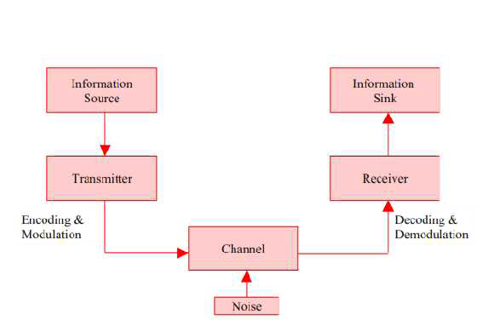
Elements of a communication system

Slide 20
Elements of a communication system
The communication channel is the path or medium for electrical or electromagnetic transmission between transmitter and receiver.
The transmitting message received by receiver as output.
The receiver performs demodulation and decoding.

Slide 21
Data Flow
Communication between two devices can be simplex, half-duplex, or full-duplex as shown below:

Slide 22
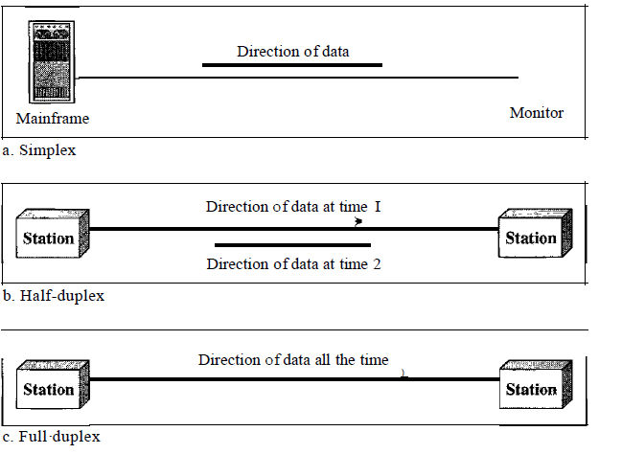

Slide 23
Simplex
In simplex mode, the communication is unidirectional, as on a one-way street. Only one of the two devices on a link can transmit; the other can only receive.
Keyboards and traditional monitors are examples of simplex devices. The keyboard can only introduce input; the monitor can only accept output.
The simplex mode can use the entire capacity of the channel to send data in one direction.

Slide 24
Half duplex
In half-duplex mode, each station can both transmit and receive, but not at the same time.
When one device is sending, the other can only receive, and vice versa .The half-duplex mode is like a one-lane road with traffic allowed in both directions.

Slide 25
Half duplex
When cars are traveling in one direction, cars going the other way must wait. In a half-duplex transmission, the entire capacity of a channel is taken over by whichever of the two devices is transmitting at the time. Walkie-talkies and CB (citizens band) radios are both half-duplex systems.
The half-duplex mode is used in cases where there is no need for communication in both directions at the same time; the entire capacity of the channel can be utilized for each direction.

Slide 26
Full duplex
In full-duplex (also called duplex), both stations can transmit and receive simultaneously
The full-duplex mode is like a two-way street with traffic flowing in both directions at the same time. In full-duplex mode, signals going in one direction share the capacity of the link: with signals going in the other direction. This sharing can occur in two ways: Either the link must contain two physically separate transmission paths, one for sending and the other for receiving; or the capacity of the channel is divided between signals traveling in both directions.

Slide 27
Full duplex
One common example of full-duplex communication is the telephone network. When two people are communicating by a telephone line, both can talk and listen at the same time.
The full-duplex mode is used when communication in both directions is required all the time. The capacity of the channel, however, must be divided between the two directions.

Slide 28
Network criteria
A network must be able to meet a certain number of criteria. The most important of these are:
  Performance
  Reliability
  Security.

Slide 29
Performance
Performance can be measured in many ways, including transit time and response time.
Transit time is the amount of time required for a message to travel from one device to another.
Response time is the elapsed time between an inquiry and a response.
The performance of a network depends on a number of factors, including the number of users, the type of transmission medium, the capabilities of the connected hardware, and the efficiency of the software.

Slide 30
Performance
Performance is often evaluated by two networking metrics: throughput and delay.
We often need more throughput and less delay. However, these two criteria are often contradictory. If we try to send more data to the network, we may increase throughput but we increase the delay because of traffic congestion in the network.

Slide 31
Reliability
In addition to accuracy of delivery, network reliability is measured by the frequency of failure, the time it takes a link to recover from a failure, and the network's robustness in a catastrophe.

Slide 32
Security
Network security issues include protecting data from unauthorized access, protecting data from damage and development, and implementing policies and procedures for recovery from breaches and data losses.

Slide 33
Data representation
Data Representation refers to the methods used internally to represent information stored in a computer. Computers store lots of different types of information:
  numbers
  text
  graphics of many varieties (stills, video, animation)
  sound

Slide 34
ALL types of information stored in a computer are stored internally in the same simple format: a sequence of 0's and 1's
Computers use numeric codes to represent all the information they store. E.g
  let 1 stand for A,
  2 stand for B, etc.
  With this code, any written message can be represented numerically.

Slide 35
The codes used by computers are a bit more sophisticated, and they are based on the binary number system (base two)
Computers use a variety of different codes. Some are used for numbers, others for text, and still others for sound and graphics.

